Slide 1
Own
Your
WordPress:
From Noob to Knowledgeable in .002
Notes:
Thank you for coming today! Thank you to WordCamp Santa Clarita for hosting this event and for having me speak. I’m so happy to see everyone here and I’m excited to chat with you about WordPress! This talk starts out with super basic stuff for brand new WordPress users and progresses to more advanced developer concepts about half way through. We’ll go over some fundamentals about WordPress itself and then talk about code and custom code in the WordPress space.

Slide 2
Amy Kamala
Notes:
$whoami I’m Amy and I’ve been working as a WordPress technician for over 5 years, helping thousands of users across the globe be more confident and more capable in working with their WordPress websites. I’ve worked with clients both beginner and advanced, and on many different types of websites. I’m also a WordPress contributor, which means I volunteer time and effort to the WordPress Open Source project to support the software and community. I’m a hosting team rep, a WordCamp organizer and a WordPress MeetUps organizer, and I’m happy to help people learn and grow their skills.

Slide 3
What is WordPress?
Notes:
What is WordPress? WordPress is a software or an app, or more specifically a Content Management System which is used for creating and managing a website, ecommerce shop or blog. Automattic, the parent company of WordPress, has stated that its mission is to democratize publishing. Meaning that WordPress is intended as a platform that gives anyone and everyone a voice. The software is open source and free which makes it inclusive and diverse, which are concepts on the forefront of the WordPress project and community.

Slide 4
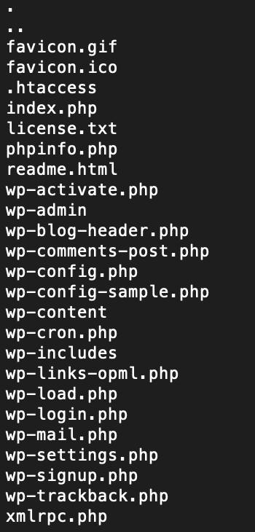
WordPress:
Software/App/Content Management System used for creating websites and blogs.
Core files/folders ---->
Made with PHP/HTML/CSS/JS
Uses SQL Database
Lives in LAMP/LEMP Environment
Extensible through plugins and themes
Open Source & free
Notes:
On the right are the WordPress core php files and folders which all start with a ‘wp’ prefix. WordPress is comprised of PHP, Javascript, CSS and HTML coding languages, as well as SQL Syntax, and consists of these core php files and 12 core database tables.
WordPress has point and click capabilities in its wp-admin panel and allows for extensibility via themes and plugins. Which means you can extend and customize the functionality and look of your WordPress site using plugins and themes.

Slide 5
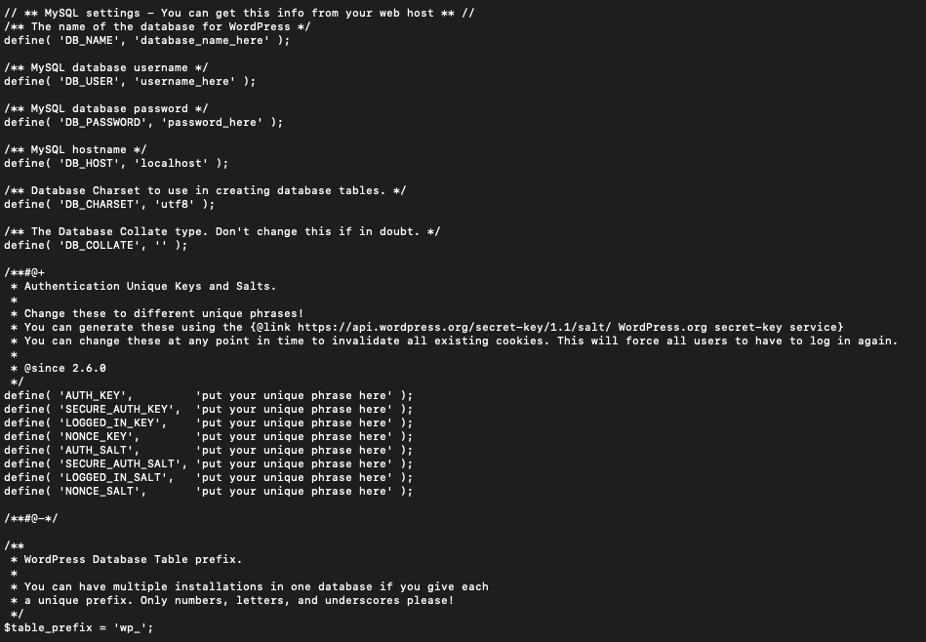
The wp-config.php file
• In a WordPress install the wp-config.php file is used for establishing a secure database connection, applying security salts and a number of primary settings. It can be customized to add more functionality such as browser-side cache.
*make sure you use straight ‘ and not curly ‘
Notes:
One of the most vital files in a WordPress install is the wp-config.php file. This file enabled the the website files to connect to the database, contains security salts and can be customized in a variety of ways to manage and maintain your WordPress install.

Slide 6
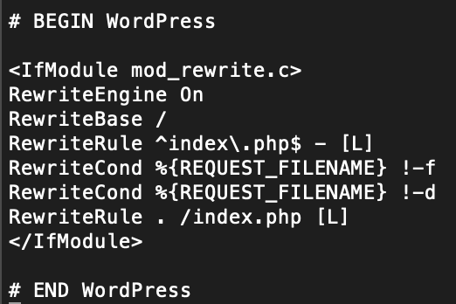
The .htaccess file
In a LAMP environment, the .htaccess file interacts with the Apache service to determine how the site is delivered to visitors. In WordPress, the .htaccess file regulates pretty permalinks (links with the post name in them). WordPress Generates the .htaccess file for you when permalinks are set.
Notes:
The .htaccess file is another vital file for a WordPress install if you use pretty permalinks on a LAMP environment. Pretty permalinks means the link contains the name of the post. In a LAMP environment (linux, Apache, MySQL and PHP) the .htaccess file communicates information about the site with the Apache service, which is responsible for serving site data to your visitors. This file ccan also be customized to control certain behaviors of the site front end and backend, and if the file is missing some pages and content may not load correctly, if at all. In a LEMP environment, one that uses NGginx instead of Apache, the .htaccess file is not needed.

Slide 7
What Are Themes and Plugins?
WordPress Theme:
An active theme is required for WordPress to function
Themes live in the wp-content/themes folder
Determines the look and layout of the website
Determines the color scheme and fonts used
Controls menu and website hierarchy
WordPress Plugins:
Add-ons that provide extra functionality beyond core functions
Live in the wp-content/plugins folder
Notes:
Themes and plugins are another vital element when working with WordPress. A theme determines the way the website looks, and plugins add extra functionality on top of what WordPress core offers. You can install themes and plugins at will, or not at all, although at least one theme is required to be active for WordPress to function.
Extensibility, the ability to extend the functionality of the site, is one of the things that makes WordPress great to use. With the option of installing free and premium add-ons or coding your own add-ons, the extent of potential WordPress functionality is endless. We’ll talk more about themes and plugins in a bit.

Slide 8
WordPress Database Basics
A database is a system for storing data so applications and websites can retrieve that data efficiently and on demand.
Databases use ‘tables’, ‘rows’ and ‘columns’ as the pillars of its structure, much like a spreadsheet.
Most WordPress website content is stored in a SQL database.
post content
page content
comments
user data
permalinks / slugs
attachments
Notes:
The database is a fundamental part of a WordPress website as the majority of site content is stored in the database. That includes post content, attachments, user data, permalinks, comments, meta data, URLs and so forth.

Slide 9
The
WordPress
Database
In a database, data is stored in tables, rows and columns, like a spreadsheet.
A WordPress Database should ideally be be less than 2 GB total
The wp_options table is used by every part of the site and stores the domain URL
The wp_users table stores user information
The wp_posts tables stores post and page data
Notes:
A database is comprised of tables, rows and columns much like a spreadsheet. WordPress core has 12 tables all of which are vital to WordPress functionality. The Domain URL and other settings are stored in the options table, which is used on every page load. Posts and pages in the posts table, comments in the comments table and so forth. The database also stores meta data, which is data that isn’t visually seen on the front end but is still read by computers.

Slide 10
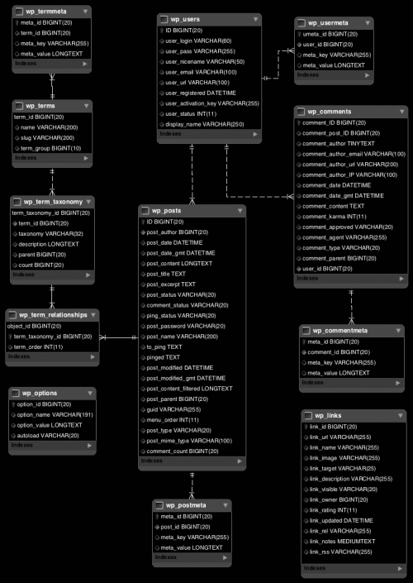
Database Schema
Notes:
This is a map of what makes up a WordPress database and how the different tables are tied together. This might seem complicated at first but it’s actually a simple, easy to use database schema or structure, as far as databases go. The database is usually stored in a separate MySQL or Maria DB server, while the core php and other core files are housed on a web server.
There are different types of storage engines (which are methods to store and retrieve data) when it comes to databases, and WordPress uses InnoDB by default because it’s more performant.

Slide 11
Wp-admin
Site
Administration
Allows WordPress to be managed with point and click options
Add and remove posts and pages
Add, activate and deactivate themes and plugins
Updates can be done in wp-admin
Manage comments, users and media
Manage menus and customizations
Main controls are on the left side menu
Plugins and themes add menu options
CSS can be customized in wp-admin
Notes:
Most people manage their WordPress websites using the wp-admin Administration dashboard. The dashboard provides a menu on the left with main controls, including adding and removing posts and pages, managing media, users, comments, plugins, themes and updates. Many plugins and themes add menu options to the dashboard and contain settings pages with additional options.

Slide 12
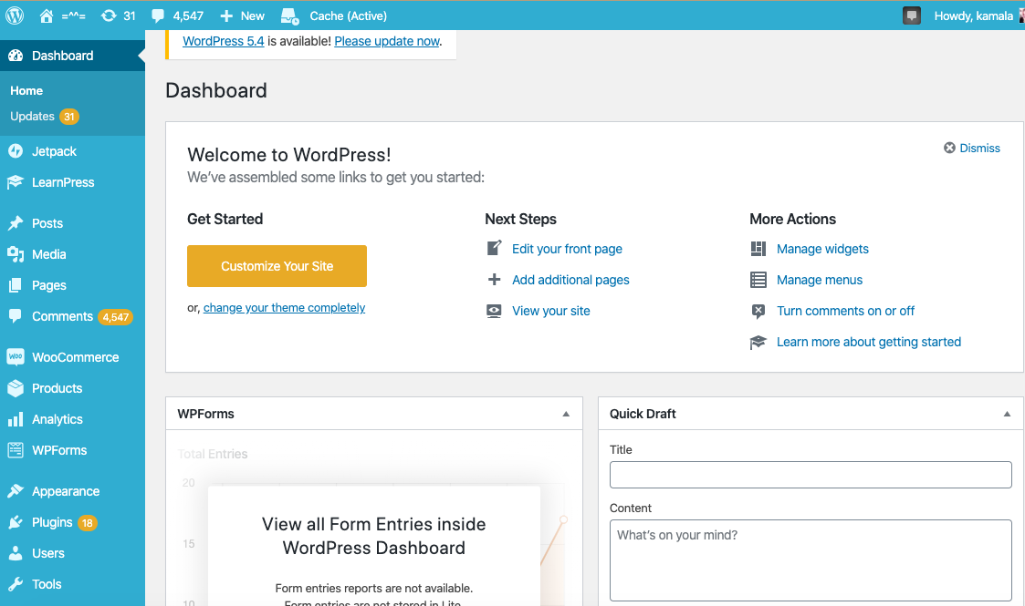
Notes:
This is my website wp-admin. As you can see I haven’t yet updated to WP 5.4 even though it came out a few weeks ago. I also have not been managing my comments. Anyway, on the left you see some native WordPress options listed, for Posts, Pages, Media and Comments as well as some options added by plugins like WooCommerce and JetPack.

Slide 13
Gutenberg
Block editor introduced into WordPress Core in version 5.0
Allows web content to be added to pages and posts using point, click and drag capabilities.
Provides a variety of layout options for individual sections of a page or post.
Provides a text editor, options for embedding content, and the ability to apply custom code to individual sections of a page.
Click the little + circle to add a block in a page or post.
Notes:
In wp-admin you can create, edit and manage website content. The Gutenberg block editor is the interface that is native to WordPress for adding and managing content. Gutenberg was introduced in WordPress 5.0 and since then has evolved quite a bite in its abilities. Gutenberg now provides a pont, click and drag interface that allows you to add headings, paragraphs, images, galleries, embed third party content or even insert custom code. To start using Gutenberg in wp-admin you just need to click the little plus circle icon to add a section.

Slide 14
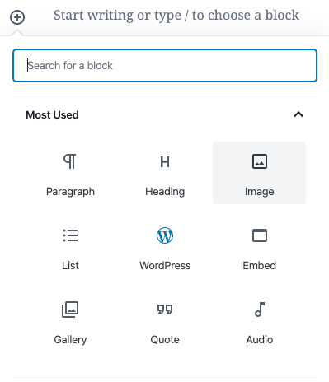
Notes:
When you click the + icon, options appear for selecting the type of content the block or section will contain. Gutenberg blocks reflect HTML elements and page hierarchy or markup. So you can make a paragraph, list, heading, embed an image, gallery or content and so forth just with a few clicks by selecting one of these options and following the prompt.

Slide 15
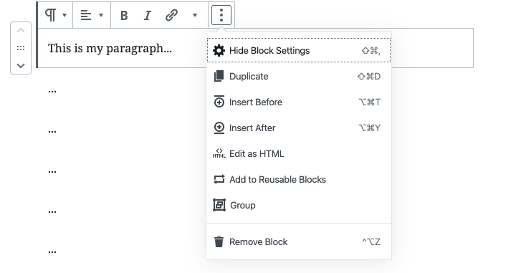
Notes:
Once you have a block added you can edit it by clicking on it one time, and more options will appear for managing the block. You can find even more options by clicking the three dots on the upper right. You can also nest blocks inside each other, add a block to be re-used in a similar way to a template and build custom blocks.

Slide 16
File and Data Management
You can connect to your server via SSH using a terminal client, to manage your files with command line.
You can edit files in your browser with https://yourdomain.com/wp-admin
You can upload, download, edit files with an S/FTP client like FileZIlla, Cyberduck or similar
You can manage your database content using a client such as PHPmyadmin or MySQL WorkBench
cPanel does all of the above (except SSH)
Notes:
Ok, now we’re getting more into the technical stuff. For editing website files and data, there are a few different options, such as S/FTP, CPanel and PHPmyadmin. cPanel is popular because it allows you to do a variety of functions rolled into one interface.

Slide 17
Intro to SSH / Command Line Basics
Login with the command ssh username@yourserver.com (contact your host for credentials and instructions)
Make new file: pico <filename> Exit pico: ctrl + o to save and ctrl + x to exit
Edit a file: nano <filename> Exit nano: ctrl + o to save and ctrl + x to exit
Edit a file: vim <filename> Exit vim: press esc + shift + ; then rq + enter (to save)
Move a file: mv <filename> /new/location/
Copy a file: cp -r <filename> <newfilename> Delete a file: rm -R <filename>
Navigate between folders: cd /path/to/folder Navigate one folder backwards: cd ..
Check CPU usage: top -c Check memory usage: free -m
Notes:
Command line is my favorite tool for file management. You can connect to your server using an SSH login and a terminal software like terminal or putty. Using command line can speed up your process and provides a variety of manual options for WordPress site maintenance. These are a few basic commands to get started with. If you want to really own your WordPress you have to learn command line.

Slide 18
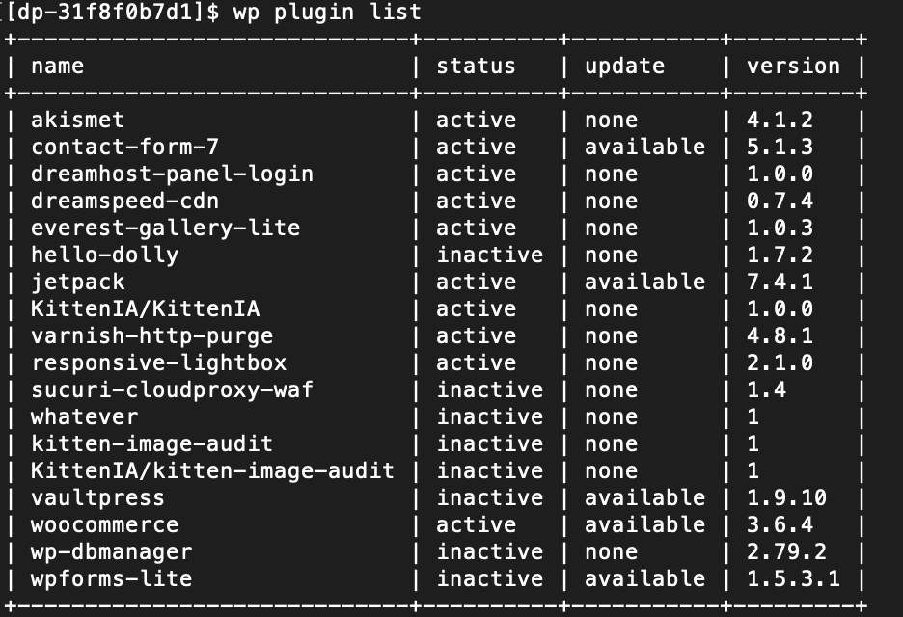
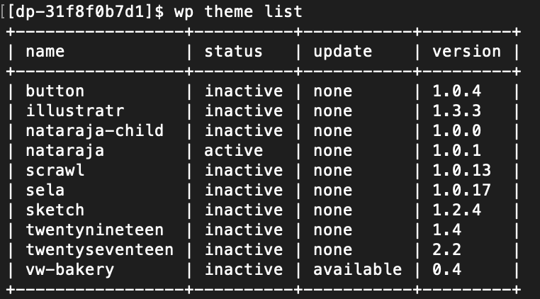
Working with WordPress Command Line
Make sure WordPress is up to date! Check WP Core version with ‘wp core version’
:
Check installed plugins and their status with ‘wp plugin list’ and ‘wp plugin status’
Check Installed Themes and Their Status with ‘wp theme list’ and ‘wp theme status’
*Find more commands on: https://developer.wordpress.org/cli/commands/
Notes:
WordPress has its own command line built into core. It’s incredibly useful and a great tool for working with an install. You can use WordPress command line to check on theme, plugin and core health, to add, remove, activate and deactivate plugins and themes, to debug errors and performance and to push updates through.

Slide 19
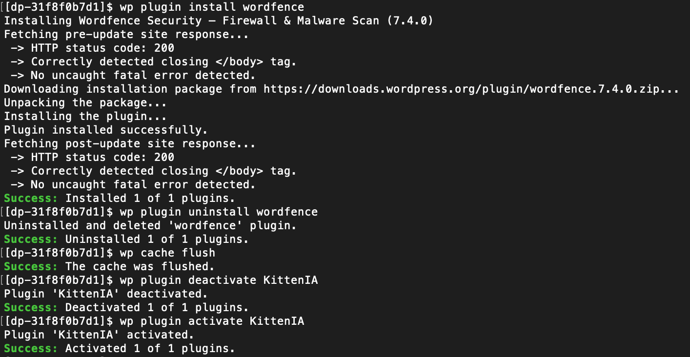
WP Cli Updates, Re-Installs, Un-Installs
Update Core, Force Core Download, Flush Cache ‘wp core update’ ‘wp core download’ ‘wp cache flush’
Install, Un-Install, Deactivate, Activate ‘wp plugin install <plugin>’ ‘wp plugin uninstall <plugin>’ ‘wp plugin activate <plugin>’ ‘wp plugin deactivate <plugin>’
Update Plugins and Themes ‘wp theme update <theme>’ ‘wp plugin update <plugins>’
Notes:
Here are some commands for installing and re-installing core, running updates, activating and deactivating items. All you need is an SSH connection and most hosts have WP-CLI installed by default, as WordPress Command Line a native part of WordPress.

Slide 20
Code
Is
Poetry
WordPress is made of these coding languages:
PHP
Javascript
CSS
HTML
SQL Syntax
Notes:
From command line to code. Getting more technical now. :) WordPress is made of code, which is text that communicates with a web server and browser to run processes. WordPress is composed of multiple different coding languages. PHP is a programmatic language and is the backbone of WordPress, but SQL Syntax is used for database communication, Javascript is used for interactive functions on the front end, and html and CSS are mark-up languages used strictly on the front-end to frame and style website content.

Slide 21
Basic HTML
<!DOCTYPE html>
<html>
<body>
<h1>Title or Heading</h1>
<h2> Sub-Heading </h2>
<h3> Sub-Sub-Heading </h3>
<p>My first paragraph.
<a href="https://www.url-here.com"> link text here </a>
<img src="image-here.jpg" alt="alt text here" width="100" height="150">
<button> button text here </button>
</p>
</body>
</html>
Notes:
HTML is the most common language as it’s used on every website. It’s the main language web browsers use. When you write html you always start with an identifying tag that tells the browser that its reading html code. Actual website content goes inside a <body> tag, and html allows you to plugin content inside the tags to determine where and how that content is displayed. The h tags are for headers, like page titles. The p tag is for paragraphs, img tag for images, href for links, button tag for buttons and so forth.

Slide 22
Basic CSS
CSS: Cascading Style Sheets
Controls the look of a website
Stored in seperate CSS files
Used in conjunction with theme
Works alongside html
Is used on every website
h1 {
text-align: center;
color: red;
}
h2 {
text-align: center;
color: red;
}
p {
text-align: center;
color: red;
}
Notes:
CSS stands for ‘cascading style sheets’ and is used to control certain aspects of the way the front end website looks. CSS determines how the web page is displayed to users. CSS is saved in it’s own file type and can be applied site-wide or just to certain pages and elements. Things like color scheme, padding, borders and the like can be controlled with CSS. On the right is what CSS looks like on the most basic level. The parts that say h1, h2 and p are called selectors because they identify which part of the html code on the website is being styled. Color and text-align are properties that determines certain aspects of the selector, and center and red here are the property values. Of course CSS gets far more complicated than this. This is just an introduction.

Slide 23
PHP
Object Oriented
Programming
WordPress uses Object Oriented programming which focuses on data and procedures encapsulated inside a data object. OOP is:
More secure
Easier to maintain
Makes functions reusable without having to rewrite code
Establishes a clear structure within the program or software.
Notes:
WordPress uses PHP Object Oriented Programming, which allows for a variety of internal functions and other options to be embedded into site code and utilized as needed. Standard programming or coding is procedural, which is focused on creating a series of procedures or functions to run operations within the software. Object Oriented Programming is similar in that procedures are still created, but in OOP the functions and procedures are encapsulated within a repeatable, re-useable data object that contains both information and processes that can be run. OOP is more secure, easier to maintain, requires programmers to write less code and code can be re-used and modified infinately, and creates a clear structure for the program or software.

Slide 24
OOP Primary Concepts
Classes
A class is like a reusable template for data, and can be considered similar to a ‘type’ or ‘category’
Classes have a set of properties that are inherited by Objects
Example:
Vegetables
Objects
An object is an instance of a class or a a specific version of a class that has been customized or modified
Objects inherit the properties of classes which then can be modified for that object type.
Example:
Carrots
Lettuce
Asparagus
Potatoes
Notes:
In OOP a ‘Class’ is similar to a template for Objects, and it can be correlated with the idea of ‘type’ or ‘category’. An Object is an instance of that class, meaning it’s an encapsulated version of it’s class which inherits all of the classes’ properties which can then be customized and modified. For example: Vegetables are the class while carrots, lettuce, potatoes are objects of the vegetable class. Fruit can be a class while bananas, oranges and apples are objects of the class. They are all fruit, with the global properties of fruit - they grow on a tree, they contain sugar and juice, but each fruit or object has it’s own set of properties in addition to the class properties.

Slide 25
• A Class is defined by the class keyword and curly braces {}. Properties and methods go inside the {}.
• An Object is declared with the ‘new’ keyword. Here, apple is an instance of Fruit.
• The $this keyword is used to identify the class from within one of it’s methods
• Getters and Setters are types of functions used to modify (set) or retrieve (get) object properties
• Public properties and functions can be accessed from anywhere in the program.
• Private properties and functions can only be accessed from within the class itself.
• Protected properties and functions can be accessed from within the class, and from within objects of the class.
<?php
class Fruit {
//Variables are called Properties
public $name;
private $color;
protected $color;
// Methods are called Functions
function set_name($name) {
//code to be executed goes here
$this->name = $name;
}
function get_name() {
return $this->name;
}
}
$apple = new Fruit();
$apple->name = "Apple";
echo $apple->get_name();
?>
Notes:
A class is defined using the ‘class’ keyword and a pair of curly braces. Properties and functions belonging to that class go inside the braces. An object of a class is created using the ‘new’ keyword, outside of the curly brackets. In a class the $this keyword is used to identify the class in use from within its own functions. Getters and Setters are used to retrieve (get) and define (set) properties of the object or class. A public property or function can be accessed from anywhere in the program. Private properties and functions can be accessed only from within the class itself. Protected ones can be accessed from within the class, as well as from within objects of the class. Again, this is just the basic stuff. There is a lot more that goes into object priented programming than this but this is the info that can get you started.

Slide 26
WordPress
Hooks,
Actions and
Filters
Hooks are used to link plugin and theme code to the rest of the WordPress website.
There are two types of hooks:
Actions: Allow data to be added to WordPress functionality
Added to code with a add_action or do_action command
Filters: Allow existing WordPress data to be modified as it’s executed
Added to code with a add_filter command
Notes:
Ok, back to WordPress. WordPress is created with Object Oriented Programming and has a variety of properties and functions that can be accessed when writing plugins and themes. In addition, plugins and themes have their own functions that can be written to modify WordPress functions. For plugins and themes to connect their code to the rest of the WordPress install, something called a hook is used. There are two types of hooks called actions and filters. Actions allow you to add code to the WordPress install for additional functionality, while Filters allow you to modify existing code to change functionality is the code is executed.

Slide 27
Hook Syntax
add_action( 'example_action', 'example_callback', 10, 2 );
add_filter( 'example_filter', 'example_callback' );
Notes:
Ok, so Syntax is the coding equivalent of grammar. You have to use correct syntax in order for your code to work, and each language has its own syntax. In this case the syntax for hook functions is defined within WordPress core code. Hooks use something called a callback, which means a function is called to execute from within another function. Here the example action refers to the hook you want to use, and the example callback refers to the function you wish to call run. The numbers at the end refer to the priority of the hook within the WordPress install, as well as the arguments accepted by the callback, which is sort of like information the function expects to receive.

Slide 28
Plugin Structure
Plugins:
Can be one file or a collection of files
Lives in wp-content/plugins folder
Main file and directory must be named the same as the plugin name
Must contain a standard WP plugin header inside the main file to identify the plugin within WordPress
For best security a plugin is broken up into multiple files and sub-directories with an uninstall.php file in the root, and other functions and styles broken up into individual folders and files.
Plugin functions and classes usually have a custom prefix to make the code unique and avoid overlapping with other plugins and themes.
Notes:
When coding a WordPress plugin certain requirements must be met in order for the plugin to work. There are additional best practices that are recommended by WordPress but we will just cover the basic stuff here. A plugin can be made of one file or a collection of files. Plugins live in the wp-content/plugins directory.

Slide 29
Plugin Structure
/plugin-name
plugin-name.php
uninstall.php
/languages
/includes
/admin
/js
/css
/images
/public
/js
/css
/images
Notes:
A plugin can be made of one file or a collection of files. Plugins live in the wp-content/plugins directory. If a plugin is made of multiple files in a directory, as opposed to one file, it’s structure should look like the this within the Plugin directory. The slashes indicate a folder and the indented ones are contained within the folder above it. So everything is in the plugin-name folder, then there are includes, admin and other folders that can contain files and functions within them. You connect those files and functions into the main plugin and WordPress install using hooks.

Slide 30
Plugin Header
The main plugin file must contain the plugin header with the “text domain”, or the name of the plugin in it. The file name must match the text domain used in the header.
Example: plugin-name-here.php
Some of these items can be left blank such as the Author URI and plugin URI.
<?php
/**
* Plugin Name: Plugin Name Here
* Plugin URI: https://example.com/plugin
* Description: What it does here
* Version: 1.0.0
* Requires at least: 5.2
* Requires PHP: 7.2
* Author: Own Your WordPress
* Author URI: https://kittenkamala.com
* License: GPL v2 or later
* License URI: https://www.gnu.org/licenses/gpl-2.0.html
* Text Domain: plugin-name-here
Notes:
When coding a WordPress plugin certain requirements must be met in order for the plugin to work. There are additional best practices that are recommended by WordPress but we will just cover the basic stuff here. The main file of the plugin must contain the plugin header which tells WordPress the information about the plugin. The main plugin file and the directory the plugin lives in must match the text domain.

Slide 31
Plugin Activate, Deactive, Uninstall
register_activation_hook( __FILE__, 'prefix_function' );
register_deactivation_hook( __FILE__, 'prefix_function');
register_uninstall_hook(__FILE__, 'prefix_function');
Notes:
Plugins have standard hooks for activation, and deactivation, and uninstall, which are primary functions for plugins and themes. WordPress best practices, recommends using an uninstall.php file for the functions that are triggered on uninstall if the plugin is not a one-file plugin. These hooks would exist outside of the class curly brackets, and you can either call a separate file or call an instance of the class in the first part where it says __FILE__. The second part on the right is the function that should be triggered when the hook is used.

Slide 32
WordPress
Themes
WordPress themes live in the /wp-content/themes folder.
WordPress themes are made of multiple template files within the theme folder.
An index.php file is required in all themes
Most themes contain multiple files and folders
Template hierarchy determines what file is loaded for a request
The web server reads the php code and outputs html to the front end.
The content displayed on the page is pulled based on post type, which is a value stored in the WordPress database.
Custom Post Types are often created for creating and managing custom content displayed by the theme.
Default post types are ‘page’ and ‘post’ and are stored in the wp_posts table.
Notes:
WordPress themes are made up of multiple different template files within the theme folder. Themes only require an index.php file but most themes contain multiple different files and folders. The template hierarchy determines what theme files load for a request, and then the web server parses the php code and outputs html to the front end. The content displayed in page templates are based on post types, which is a value stored in the WordPress database. The two default post types are page and post, however custom post types and associated data can be created within a theme or plugin.

Slide 33
Theme Structure
/assets
/css (contains css files)
/images (contains image files)
/js (contains js files)
/inc (contains custom functions/files)
/template-parts
/footer (footer files)
/header (header files)
/navigation (nav menu files)
/page (page template files)
/post (post template files)
404.php
Archive.php
style.css
Notes:
This is what a standard theme file structure looks like. This would all live within the theme directory in the wp-content/themes folder. Again, the slashes here are for directories which would contain files, template files and partials.

Slide 34
Theme Template
Files and partials
A template file is used to create a layout for certain page and post types.
index.php
home.php
single.php
single-(post-type).php
page.php
comments.php
A template partial is used to create just part of a page such as the header and footer, which can then be loaded globally on the entire website, or called dynamically.
header.php
footer.php
sidebar.php
Notes:
Themes are made of template files and template partials. A template file outlines the structure for the entire theme, while a partial outlines the structure for a certain part of the theme such as the header or footer.

Slide 35
Theme Template
Functions
To include the header: get_header()
To include the sidebar: get_sidebar()
To include the footer: get_footer()
To include the search form: get_search_form()
To include custom theme files: get_template_part()
Notes:
WordPress has functions baked into it that can be called within theme template files. They’re pretty self explanatory, for instance you use get_footer to load the footer in a template. You use get_header to load the header and so forth. Code is read from top to bottom so you would place these functions in the order you want the partials to be displayed.

Slide 36
Theme Templates
This is what a very simple theme template looks like:
<?php get_sidebar(); ?>
<?php get_template_part( 'featured-content' ); ?>
<?php get_footer(); ?>
Notes:
This is what avery very simple theme template file would look like. You declare your functions within a php tag and specify what partial should be loaded within the function details, if a custom partial is being loaded.

Slide 37
Theme
Headers
Themes use headers within CSS files. This is the header from the twentyseventeen theme:
/*
Theme Name: Twenty Seventeen
Theme URI: https://wordpress.org/themes/twentyseventeen/
Author: the WordPress team
Author URI: https://wordpress.org/
Description: Twenty Seventeen brings your site to life with immersive featured images and subtle animations...
Version: 1.0
License: GNU General Public License v2 or later
License URI: http://www.gnu.org/licenses/gpl-2.0.html
Text Domain: twentyseventeen
*/
Notes:
Themes use CSS style sheets to style the look and feel of the front end of the website. CSS files are usually loaded from a sub-directory and contain the theme header info.

Slide 38
Theme
Styles
Main styles file is named style.css and lives in the root theme folder
Additional style files live in the /css folder
To enqueue (load) a file you use the wp_enqueue_style function
Enqueue style.css: wp_enqueue_style( 'style', get_stylesheet_uri() ); Enqueue from /css: wp_enqueue_style( 'slider', get_template_directory_uri() . '/css/slider.css'
Notes:
To load or enqueue a stylesheet on the front end you use the wp_enqueue_style function. Here you see examples of how to load a style sheet both from the root folder and from a css subfolder. You would use this within your template or partial file and you can create styles that correspond to that file or partial, while style.css in the root theme folder are applied to the entire theme.

Slide 39
Own
Your
WordPress:
From Noob to Knowledgeable in .002
Notes:
So, this has been a lot of foundational stuff for getting started with WordPress and WordPress development. Of course it becomes far more elaborate than this but these basics point you in the right direction. We haven’t covered how to make custom post types or how to make custom blocks, which are slightly more advanced topics. However this foundational stuff is the groundwork for becoming a WordPress developer, and goes beyond what the average user knows.

Slide 40
Thank you!
Ask me questions!
Notes:
Thank you all so much for coming today. I hope you enjoyed this talk. Please feel free to ask me any questions and hopefully I can answer them. :)

